Slide 1

Green Pace
Security Policy Presentation
Developer: Janece Gates

Slide 2

OVERVIEW: DEFENSE IN DEPTH
We've adopted a 10-principle security policy, ensuring a proactive defense against potential vulnerabilities and threats. In an era of rapidly evolving digital threats, safeguarding our systems is paramount. Breaches can have dire consequences, from data theft to significant financial losses.
Our policy champions multi-layered security: Input Validation, Design & Architecture, Least Privilege & Default, and QA & Secure Coding. By layering these defenses, we ensure that even if one is compromised, others stand guard, making breaches significantly harder for attackers.

Slide 3
THREATS MATRIX
Risk More Likely To Happen STD-002-CPP STD-003-CPP STD-004-CPP STD-005-CPP STD-010-CPP | High Risk/Threats that need attention STD-003-CPP STD-004-CPP STD-005-CPP STD-008-CPP
Risks of Lower Priority STD-001-CPP STD-002-CPP STD-006-CPP STD-007-CPP STD-009-CPP STD-010-CPP | Risks Less Likely To Happen STD-001-CPP STD-006-CPP STD-009-CPP
Notes:
kdpojfe

Slide 4
10 PRINCIPLES
Validate Input Data -- SQL Injection
Heed Compiler Warnings -- Data Type
Architect and Design for Security Policies -- Assertions
Keep It Simple -- Organization
Default Deny -- Authentication and Authorization
Adhere to the Principle of Least Privilege -- Authentication and Authorization
Sanitize Data Sent to Other Systems -- String Correctness
Practice Defense in Depth -- Exceptions
Use Effective Quality Assurance Techniques -- Memory Protection
Adopt a Secure Coding Standard -- Data Value, Logging and Auditing

Slide 5
CODING STANDARDS
Authentication and Authorization
SQL Injection
Memory Protection
Data Value, Logging, and Auditing
String Correctness
Exceptions
Data Type
Assertions
Organization
Memory Protection

Slide 6
ENCRYPTION POLICIES
Encryption at rest ensures that data is encrypted while stored on a disk, aiming to prevent attackers from accessing the unencrypted information. If a hacker discovers a hard drive with encrypted data and lacks the encryption keys, they would need to decrypt it to access the information.
Encrypting data during its transfer ensures security. In certain applications, like remote replication, the data might be unencrypted when stored on drive arrays but is encrypted when transmitted to maintain protection.
Compromised data in use allows access to encrypted data, whether at rest or in transit. For example, someone with access to random access memory might extract the encryption key from that memory. Once they have this key, they can decrypt the data that's stored in an encrypted state.

Slide 7
TRIPLE-A POLICIES
During the authentication process, the system confirms the user's legitimacy as an authorized user. This often involves entering login credentials like a username and password to access specific system parts. Modern methods increasingly employ multi-level or two-factor authentication.
A user's permissions within the system are defined by their authorization. This dictates if the user can read, create, delete, or modify database files. It can also influence a user's capability to add or delete users and files from the system.
Accounting involves tracking a user's activities based on their system permissions. It logs which databases have been accessed, the actions taken during access, and the identity of the user who first entered the system.

Slide 8
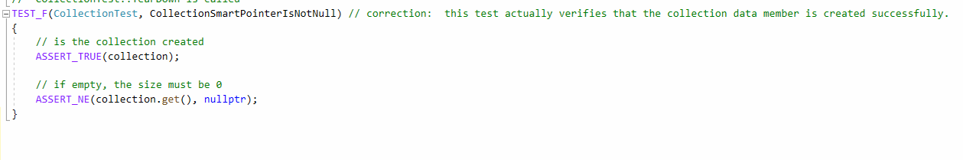
Unit Testing Is the Collection Initialized Properly?
Vulnerability: Null Pointer Dereference
Test Type: Positive

Slide 9
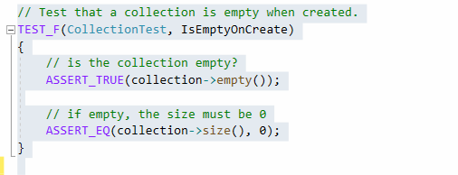
Unit Testing Is the Collection Empty Upon Creation?
Vulnerability: Improper Initialization
Test Type: Positive

Slide 10
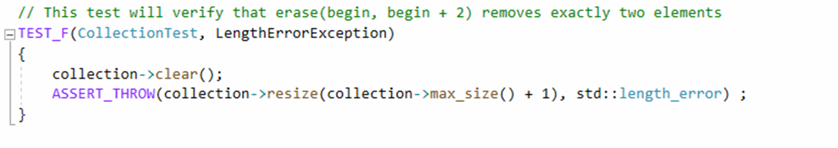
Unit Testing Does Exceeding the Maximum Collection Size Throw a Length Error?
Vulnerability: Exceeding Maximum Collection Size
Test Type: Negative

Slide 11
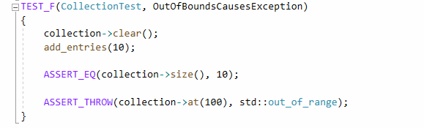
Unit Testing Does Accessing Out-of-Bounds Indices Throw an Exception?
Vulnerability: Out-of-Bounds Access
Test Type: Negative

Slide 12

AUTOMATION SUMMARY

Slide 13
TOOLS
The DevSecOps pipeline integrates security practices into the traditional DevOps process, ensuring that security is considered at every stage of software development. Green Pace's existing DevOps process will be enhanced to automate the enforcement of security standards, using the DevSecOps diagram as a reference. This approach ensures that security is not an afterthought but is embedded throughout the software development lifecycle.
External tools play a pivotal role in the DevSecOps pipeline. In the build step, Static Application Security Testing (SAST) tools scan the codebase for vulnerabilities, providing immediate feedback. During the transition to production, Infrastructure as Code (IaC) scanning tools like Terraform or CloudFormation check for potential misconfigurations, while in the monitoring phase, Security Information and Event Management (SIEM) tools and Intrusion Detection Systems (IDS) actively monitor and detect malicious activities in real-time.

Slide 14
RISKS AND BENEFITS
Acting Now:
Problems:
Initial Costs: Immediate implementation might require significant upfront investment in tools, training, and resources.
Operational Disruption: Rapid changes could disrupt ongoing projects or operations.
Solutions:
Immediate Protection: Implementing the policy now provides immediate defense against current threats.
Compliance: Some industries have regulatory requirements for security. Acting now ensures compliance and avoids potential penalties.
Risks:
Implementation Errors: Rushing might lead to mistakes in the implementation process.
Resistance: Employees might resist sudden changes, leading to potential pushback or non-compliance.
Benefits:
Proactive Defense: The organization is better protected against emerging threats.
Reputation: Demonstrates to stakeholders that the company prioritizes security.
Cost Savings: Preventing a breach is often cheaper than managing its aftermath.

Slide 15
RISKS AND BENEFITS
Waiting:
Problems:
Growing Vulnerabilities: As threats evolve, the organization becomes increasingly vulnerable.
Potential Non-compliance: Delays might lead to non-compliance with industry regulations.
Solutions:
Planned Implementation: Waiting allows for a more methodical rollout, potentially reducing mistakes.
Employee Preparation: Provides more time for training and awareness campaigns.
Risks:
Security Breaches: The longer the delay, the higher the risk of a costly breach.
Reputation Damage: Stakeholders might view the delay as negligence, harming the company's reputation.
Benefits:
Strategic Rollout: Allows for a phased implementation, aligning with other organizational changes.
Budget Allocation: Spreading costs over time might be more financially manageable.

Slide 16
RECOMMENDATIONS
1. Validate Input Data - SQL Injection: While validating input data is crucial, solely focusing on SQL injection might overlook other injection attacks.
Real-world example: The 2013 Target breach occurred due to an overlooked point of entry: their HVAC vendor. While not directly related to SQL injection, it emphasizes the importance of comprehensive input validation.
2. Heed Compiler Warnings - Data Type: Relying solely on compiler warnings might miss runtime vulnerabilities or logic-based vulnerabilities.
Real-world example: The Heartbleed bug in OpenSSL was a memory handling bug that compilers didn't catch.
3. Architect and Design for Security Policies - Assertions: Assertions are useful, but they can be bypassed in production environments if not handled correctly.
4. Keep It Simple - Organization: While simplicity is key, it's essential to ensure that the quest for simplicity doesn't compromise necessary security features.
5. Default Deny - Authentication and Authorization: This is a strong principle, but it doesn't address the need for multi-factor authentication or continuous authentication.
Real-world example: The Twitter hack of 2020 was due to social engineering. Even with a default deny policy, human elements can be a weak link.

Slide 17
RECOMMENDATIONS
6. Sanitize Data Sent to Other Systems - String Correctness: While string correctness is vital, it doesn't account for data that might be safe as a string but dangerous in another context, like script injection in web applications.
7. Practice Defense in Depth - Exceptions: Handling exceptions is just one layer. Defense in depth should encompass physical security, network security, and more.
8. Use Effective Quality Assurance Techniques - Memory Protection: Memory protection is essential, but QA should also focus on logic errors, race conditions, and other non-memory-related vulnerabilities.
9. Adopt a Secure Coding Standard - Data Value, Logging, and Auditing: Logging and auditing are crucial, but the policy should specify secure storage and timely review of these logs.
Real-world example: Sony's 2011 PlayStation Network breach saw hackers accessing information partly because of inadequate logging and monitoring.

Slide 18
CONCLUSIONS
Current Gaps:
Human Element: The policy doesn't address the human aspect of security, like training against phishing or social engineering attacks.
Physical Security: Ensuring server rooms, data centers, and other infrastructure are secure is vital.
Continuous Monitoring: Real-time monitoring and response mechanisms aren't highlighted.
Future Standards to Adopt:
Zero Trust Architecture: Assume no trust by default, even for internal actors. Every access request should be fully authenticated, authorized, and encrypted.
AI and Machine Learning: Use AI to detect anomalies in system behavior, predicting and preventing potential breaches.
Blockchain for Data Integrity: Ensure data hasn't been tampered with by implementing blockchain-based solutions.
In conclusion, while the security policy discussed covers many bases, there are gaps, especially when considering the evolving nature of threats. Addressing these gaps and looking towards future-proof solutions will ensure a robust security posture.

Slide 19
REFERENCES
SEI (Software Engineering Institute). (2020). SEI External Wiki Home. Retrieved from https://wiki.sei.cmu.edu/confluence/
Hill, M., & Swinhoe, D. (2022). The 15 biggest data breaches of the 21st century. CSO Online. https://www.csoonline.com/article/534628/the-biggest-data-breaches-of-the-21st-century.html
OpenSSL Project. (2014). OpenSSL Security Advisory [07 Apr 2014]. Retrieved from https://www.openssl.org/news/secadv/20140407.txt
Investopedia. (n.d.). Blockchain Facts: What Is It, How It Works, and How It Can Be Used. Retrieved from https://www.investopedia.com/terms/b/blockchain.asp
OWASP. (2017). A1:2017-Injection. Retrieved from https://owasp.org/www-project-top-ten/2017/A1_2017-Injection.html

